Slide 1


HuBMAP + HPA - Hacking the Human Body Competition Progress Report 10
Presentation of a Report
By
Group A
Notes:
English Title: Uppercase, Calibri size 60, XJTLU Navy
English Subtitle: Uppercase, Calibri size 36, XJTLU Navy

Slide 2


Overview
New Dataset:
1. The dataset that combine data with and without color normalization
Muti-Modal:
1. Change Channels of The Input Data
Future Plan:
1. Continue to improve the MutiModal
2. Try to use SwinUNet
Notes:
Header: Uppercase, Calibri size 28, XJTLU Navy
Body Text: Sentence case, Calibri size 14, Black

Slide 3
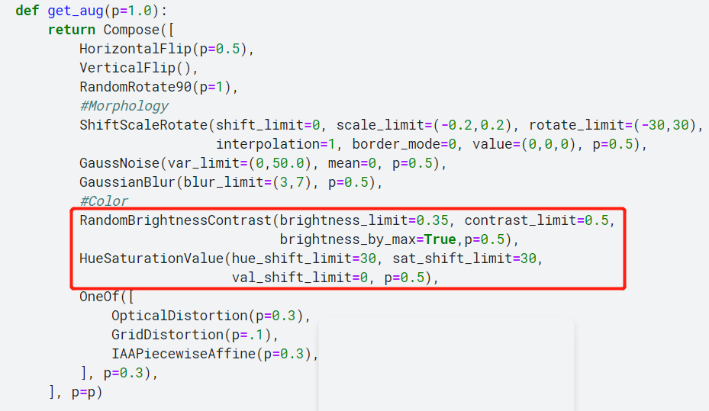
Part 1: New Dataset:
Problem of Only Use Color Normalization:
Trainning Set: HPA data
Provided Test Set: HuBMAP data
Public Test Set: HPA data and HuBMAP data
So we can't just use the color-normalized dataset but also use the
original dataset (Trainning Set: Color based on HPA data + Color
normalized set: Color based on HuBMAP)
Notes:
Header: Uppercase, Calibri size 28, XJTLU Navy
Key Text: Title case, Calibri Bold size 14, Black
Charts and tables should use the XJTLU colour palette

Slide 4



Part 1: New Dataset:
The Results of Using New Dataset:
ResNext101 Only Use Original Dataset
ResNext101 Use New Dataset
Efficient B7 Use New Dataset
Notes:
Header: Uppercase, Calibri size 28, XJTLU Navy
Key Text: Title case, Calibri Bold size 14, Black
Charts and tables should use the XJTLU colour palette

Slide 5
Part 2: Muti-Modal
Process Methods:
0
0
0
0
0
0
0
0
0
0
0
0
0
0
0
0
0
0
0
0
0
0
0
0
0
0
0
1
1
1
0
0
0
0
0
0
0
1
1
1
0
0
1
1
1
Change the input data channel from 3 to 8
RGB
Notes:
Header: Uppercase, Calibri size 28, XJTLU Navy
Key Text: Title case, Calibri Bold size 14, Black
Charts and tables should use the XJTLU colour palette

Slide 6
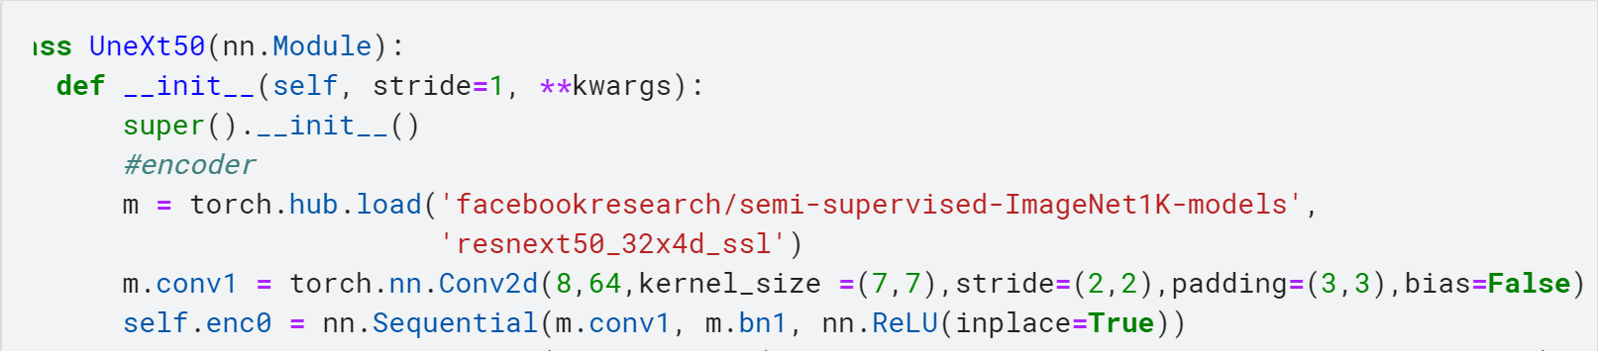
Part 2: Muti-Modal
Process Methods:
Firstly, load the pretrain model
Change the First Conv Layer
Continuing Training
Notes:
Header: Uppercase, Calibri size 28, XJTLU Navy
Key Text: Title case, Calibri Bold size 14, Black
Charts and tables should use the XJTLU colour palette

Slide 7

Part 2: Muti-Modal
The Results of Muti-Modal:
Notes:
Header: Uppercase, Calibri size 28, XJTLU Navy
Key Text: Title case, Calibri Bold size 14, Black
Charts and tables should use the XJTLU colour palette

Slide 8
Part 4: Future Plan
Try to use Multi-Modal based on different baseline such as EfficientNet and ResNext101
Try to implement the SwinUnet
Directly use the whole image for training
Notes:
Header: Uppercase, Calibri size 28, XJTLU Navy
Key Text: Title case, Calibri Bold size 14, Black
Charts and tables should use the XJTLU colour palette

Slide 9
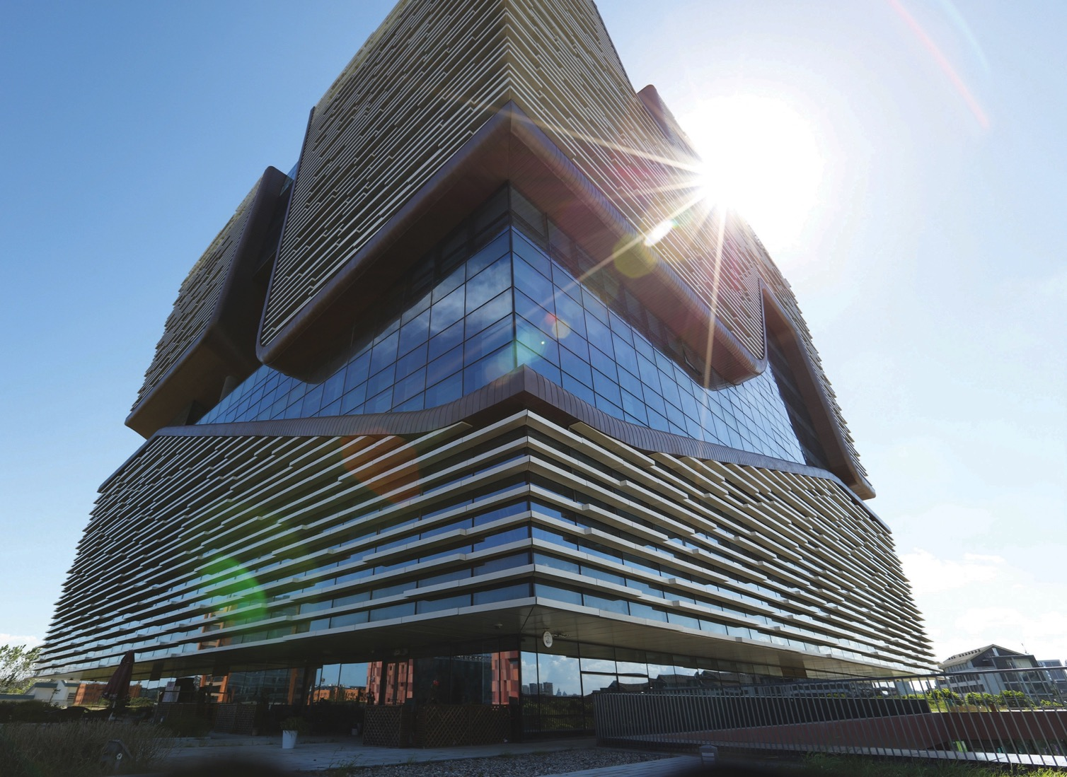
Thank you !

